Slide 1
Netflix Webkit-Based UI for TV Devices
Matt McCarthy & Kim Trott
Netflix
July 29, 2011

Slide 2
Topics
What is Webkit TV UI?
Why web?
A/B testing
Engineering for UI variation
Performance for TV devices

Slide 3
Webkit TV UI
what’s the big deal?
Notes:
Introduction: What *is* Webkit TV UI?

Slide 4




2’ UI vs. 10’ UI
2’ UI
10’ UI
Notes:
Big differences for UI design:
- Mouse & keyboard vs. remote
- Lean-forward vs. lean-back
- Solitary vs. group
Wonderlane
http://www.flickr.com/photos/wonderlane/5351266905/
Attribution 2.0 Generic (CC BY 2.0)
http://creativecommons.org/licenses/by/2.0/
a.dombrowski
http://www.flickr.com/photos/adombrowski/4791542537/
Attribution-ShareAlike 2.0 Generic (CC BY-SA 2.0)
http://creativecommons.org/licenses/by-sa/2.0/

Slide 5





Some Netflix Webkit TV UI devices
…and many more
Notes:
PS3 image from store.sony.com
Sony Internet TV image from sonystyle.com
Wii image from nintendo.com
Logitech Revue image from logitech.com
Boxee image from laughingsquid.com

Slide 6






I’m an open web.
User Agent
I’m a WebKit.
Notes:
Standardized on Webkit. No cross-browser development.
- querySelector API, CSS transforms, CSS transitions & animations, localStorage, CORS, getters and setters…
Internet Explorer logo © Microsoft
Firefox logo © Mozilla - Attribution-ShareAlike 3.0 Unported (CC BY-SA 3.0) http://creativecommons.org/licenses/by-sa/3.0/
Opera logo © Opera Software ASA
Safari logo © Apple Inc.
Webkit logo © Apple Inc. & Trolltech http://www.webkit.org/images/icon-gold.png

Slide 7
Why Web?
we did think this through
Notes:
Why not native applications?

Slide 8
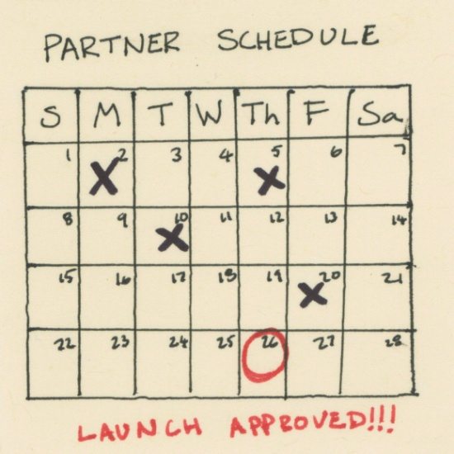
Dynamic Updates
Notes:
Dynamic updates
- Update more frequently
- Less coordination with partners
- New features & bug fixes for existing hardware

Slide 9


Common Technology
Notes:
Common technology
- Don’t have to reimplement for every platform
-- Partner just implements DPI to support our SDK
- Even if UI differs, other client-side code can be shared
Old TV photo by Susan E Adams
http://www.flickr.com/photos/susanad813/4167385353/
Attribution-NonCommercial-ShareAlike 2.0 Generic (CC BY-NC-SA 2.0)
http://creativecommons.org/licenses/by-nc-sa/2.0/
HTML5 logo by W3C
http://www.w3.org/html/logo/
Attribution 3.0 Unported (CC BY 3.0)
http://creativecommons.org/licenses/by/3.0/

Slide 10
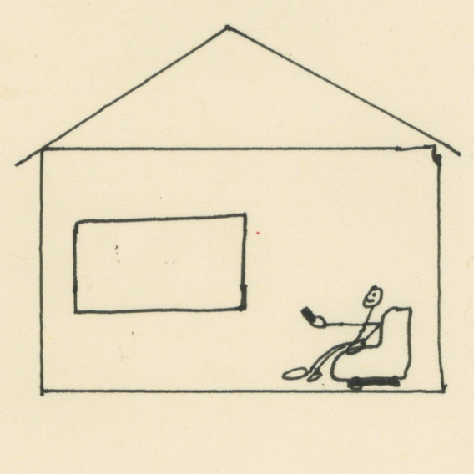




Dynamically Add Locale Support
Notes:
Add new locale support as needed
(Can require new fonts in some locales…)

Slide 11


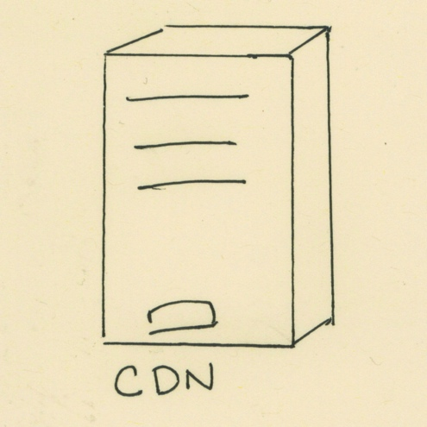



A/B Testing

Slide 12
A/B testing
because you don’t know until you try
Notes:
Streaming engagement correlates with customer retention.
“Good” UI brings us more revenue.

Slide 13
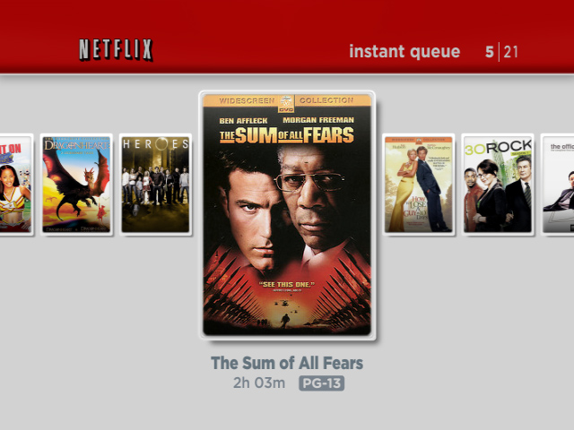
2007
Notes:
This is our first TV UI. Customers could only view titles they’d added to their instant Queue from the website.
Partners developed it to our specifications, and baked it into device firmware.
We had only rare opportunities for updates.

Slide 14
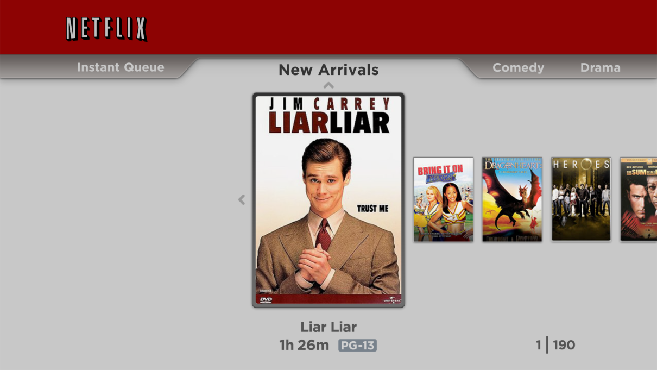
Little Iteration in Native UI
2009
Notes:
2009:
- Added a way to browse categories
- Hard to evaluate many titles rapidly
- Hard to discover category navigation
- Customers felt like they were looking at a small portion of the catalog
- 20% of customers never engaged with browsing in this UI (maybe never discovered it)
Since UI updates required firmware updates, that meant our iteration cycles were long.
Little iteration over the first few years
No opportunity for A/B testing
No opportunities for bug fixes

Slide 15
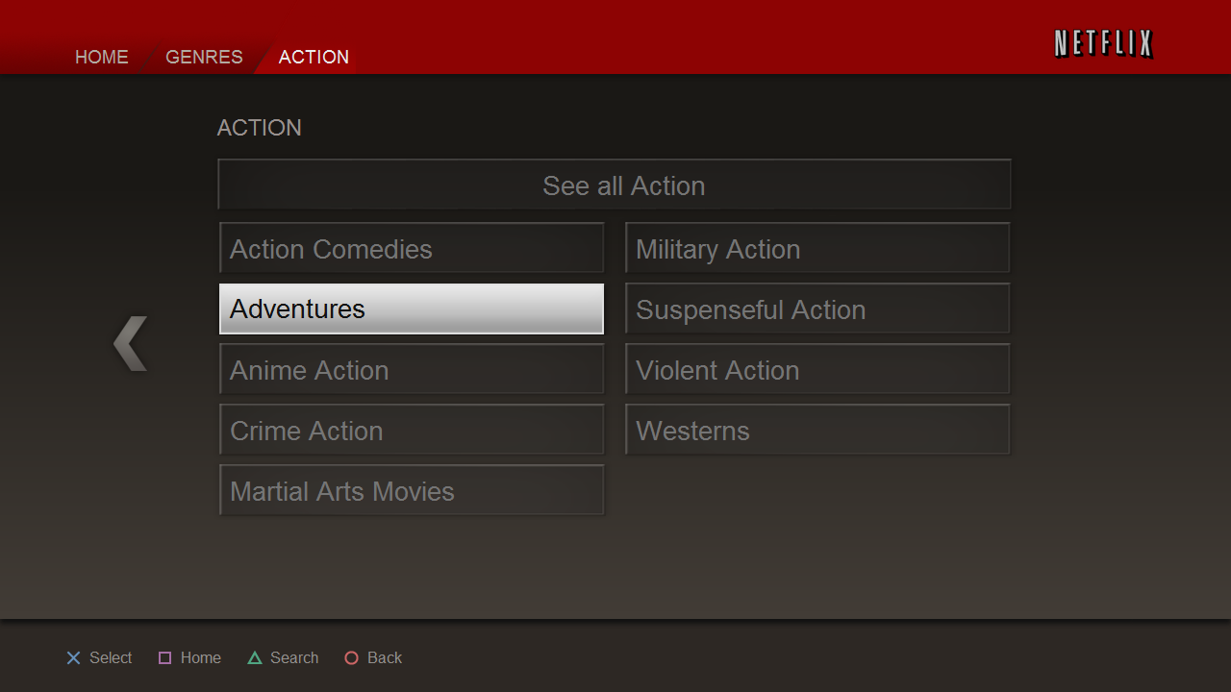
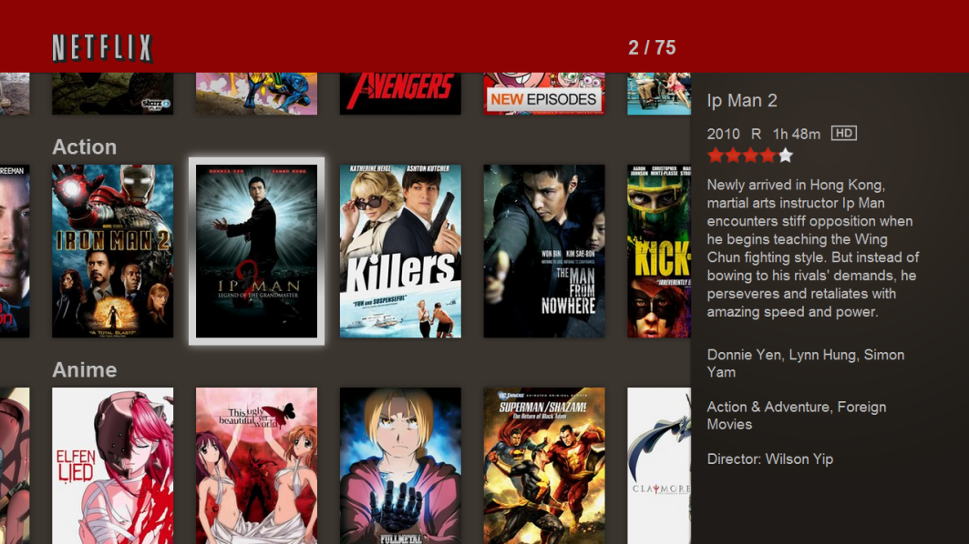
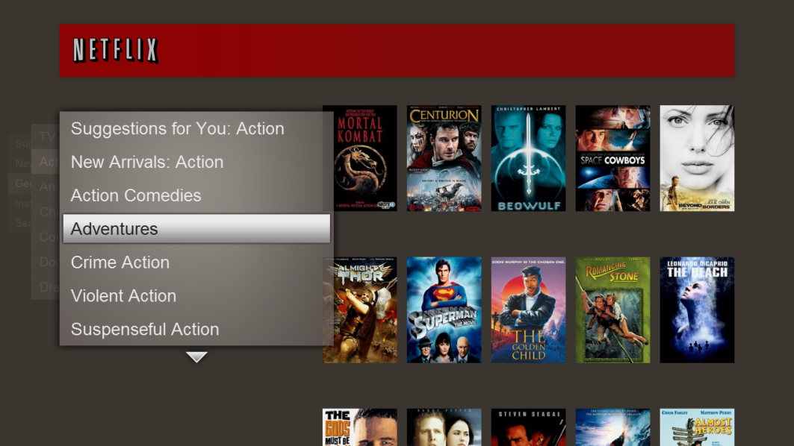
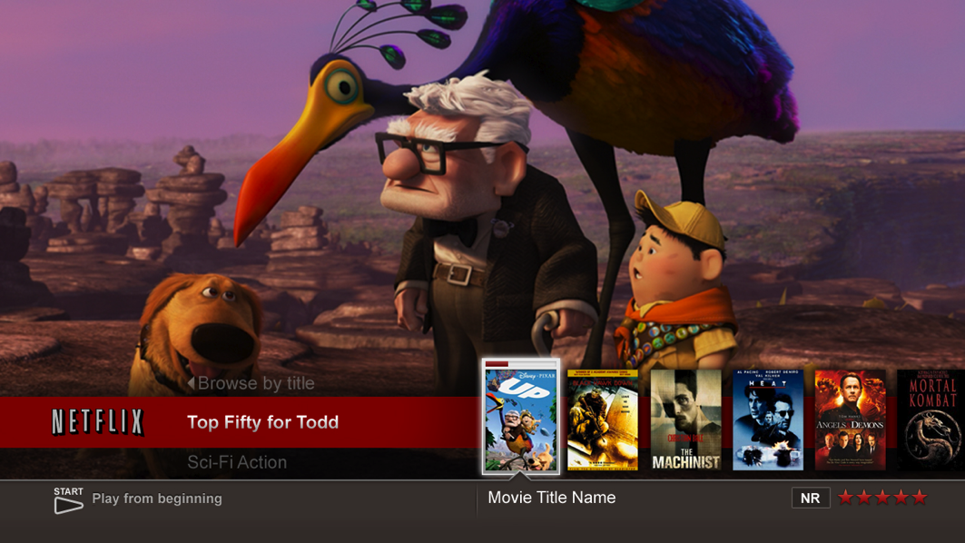
Rapid Iteration in Web UI
2010
2010
2010
2010
Notes:
2010:
- Three UIs at launch, fourth soon after
- Two-week push cycle: new features, bug fixes, and sometimes new UIs every two weeks
A new Webkit UI often takes one or two UI engineers 2-4 months to prepare for A/B testing. (More if we want to polish it for mass consumption as the default UI.)
(We’ve also developed and tested a number of UIs besides these shown here.)

Slide 16
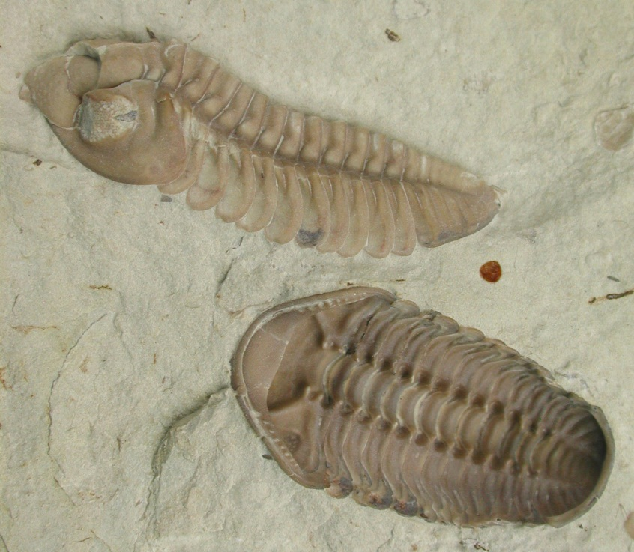



Notes:
Cambrian explosion: UIs trying to solve similar problems in radically different ways
Desktop web explosion: Eventually, websites converged a common design language.
Not all sites have all elements, but they draw from a common set of things (header, nav bar, search…).
Trilobyte image by Moussa Direct Ltd.
Licensed under Creative Commons Attribution-Share Alike 3.0 Unported license
Marrella image from Wikimedia Commons
Licensed under Creative Commons Attribution-Share Alike 3.0 Unported license
Opabinia image by Nobu Tamura
Licensed under Creative Commons Attribution 3.0 Unported license
Mosura by Toho Studios

Slide 17
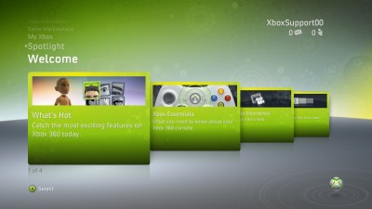
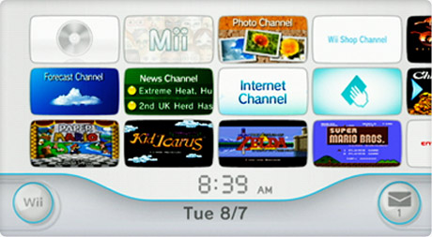
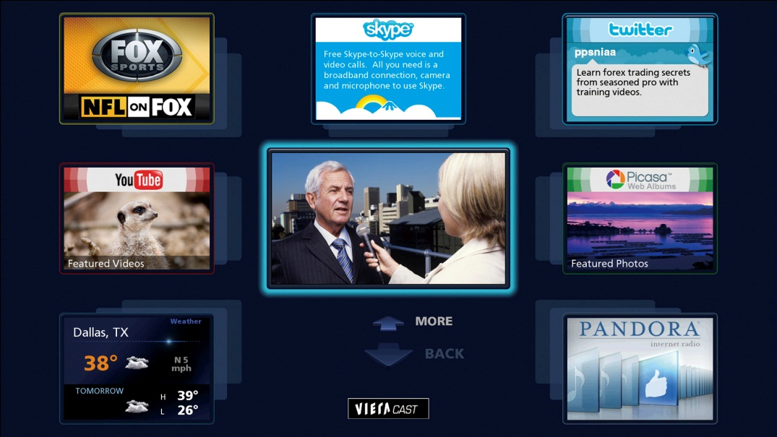
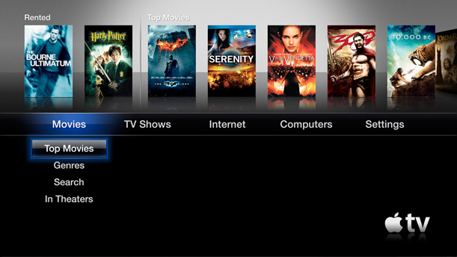
Notes:
TV UI is still in the Cambrian explosion
TV UI hasn’t settled on a common technology
Compare to mobile UI: further along, but not as mature as desktop UI
Xbox 360 screenshot from xbox.com
Wii screenshot from nintendo.com
Panasonic Viera Cast screenshot from blog.vudu.com
AppleTV screenshot from apple.com

Slide 18
Core Metrics
Retention
Streaming hours
Notes:
How do we know which version is “best”?
Retention
- The #1 most important metric for us
- Takes a long time to measure, by definition
Streaming hours
- Correlates well with retention (proxy metric)

Slide 19
Which UI led to the most streaming?
Special
Navigator
57.1%
56.3%
Plus
58.5%
Notes:
Special was our flagship UI. Favored internally.
(Describe UIs & hypotheses)
Experience & intuition isn’t enough: Sometimes we’re surprised.
Special was our flagship UI.
Plus was the underdog internally. In qualitative research, many customers who tried Plus and Special preferred Special (though many also found Special confusing).
Metric: Percent of Netflix customers (new to PS3) whose streaming hours exceeded a threshold over an early test period
* Time frame: beginning of test to whenever the numbers were harvested

Slide 20
Secondary Metrics
Application launch count
Hotkey engagement count
Discovery source (e.g. browsing, search, similar)
Which TV/movie category
Etc.
Notes:
Secondary metrics inform future UI design and further tests.
We don’t use these to determine success.
In Navigator, the cells with similar title pivoting saw 20% of plays come from that feature, which is a hint that we might want to incorporate that feature into other UIs.

Slide 21
What else does Netflix test?
Navigation schemes
Visual designs
Major UI concepts
Minor UI variations
Emphasis on movies vs. TV
Taste preference input (stars, survey…)
Presentation & explanation of recommendations
Movie discovery sources & algorithms (Queue, similar titles, genres, personalized genres…)
Recommendation algorithms
Movie list length, selection, & quantity
Website button placement, size & behavior
Website page load time
Box art size
Link/button labels
Streaming encoding quality
Streaming startup time
Sign-up design
Sign-up wizard flow
Almost every new feature
…And a lot of other stuff over the last 10 years
Notes:
What does Netflix test?
(Slew of examples)
When I started at Netflix in 2006, my sister was surprised to hear my estimate that we had maybe 80 engineers working on the website. “Why isn’t it, like, one?”

Slide 22
How we support vast variation
not just “very carefully”
Notes:
State management: Intro

Slide 23
Loose Coupling
Events
Dependency injection
Notes:
Other patterns we use
Event patterns help decouple event sources from consumers
State actions
I’ll talk about this more in a minute. (The active state is the consumer)
Observables
Consumer knows source
Source ignorant of consumer
MessageBus
Source & consumer ignorant of one another
Implemented as an Observable
Dependency injection allows us to bind components at runtime based on configuration.
It’s similar to a factory, but instead of referencing multiple components like a factory, our configuration names a specific component associated with that UI.
States/controllers
Which video playback screen does this UI use? In that screen, for this device, which keys map to which behaviors?
Navigation model
How do we get from search input to results? Are results off the right edge of the input, or the bottom, or what? Does the customer have to press a button?
Magnitude configuration
How many search results shall we fetch?

Slide 24
Example: Special
Notes:
Supporting variation: Problem description (1/2)
Consider Special. It may have dozens of UI components (menu, box art gallery, details page, episode selection, star ratings, Trick Play video skip mode…).

Slide 25
Solve These
Which component handles the next keystroke?
How & where do we model navigation between components?
…And also, these components should be reusable between completely different UIs
Notes:
Supporting variation: Problem description (2/2)
The first two would be easy if not for the third.

Slide 26
Solutions We’ve Tried & Abandoned
Tight coupling
Mediator pattern
DOM focus & events
Notes:
Supporting variation: Inadequate solution #1
Tight coupling
Decentralized components manipulate others directly
navigation.handleRight = function() { gallery.focus(); };
Easy to understand
Makes change & reuse difficult
Supporting variation: Inadequate solution #2
Mediator pattern
Giant class handles all events
Knows how all components relate
Components are 100% independent
Component relationships aren’t reusable
Say a variant UI needs all bindings from the mediator except one, or two, or ten
The mediator pattern adds a level of abstraction so that components are reusable, but the monolithic mediator is not.
Supporting variation: Inadequate solution #3
Non-DOM sources:
- Touch/gesture input that doesn’t correspond to DOM events
- Automated testing
- Voice control
- Phone controls TV
- Parts of system govern other parts
DOM focus & events
UI component = HTML element
DOM events dispatched on focused element
DOM changes are expensive
Ties controller & view
Requires DOM view
Precludes Canvas, WebGL, etc.
…Unless you decouple your controller DOM elements from your view DOM elements
Falls apart when something is interactive but isn’t rendered (yet)
Harder to take input from non-DOM sources

Slide 27
Current Solution: State Transition System
States as the C in MVC
  Can drive state transitions
States are event handling contexts
  User input
  Programmatic events
Notes:
Supporting variation: Our solution = State machine
Chain of states
How many of you have studied automata or built a state machine?

Slide 28
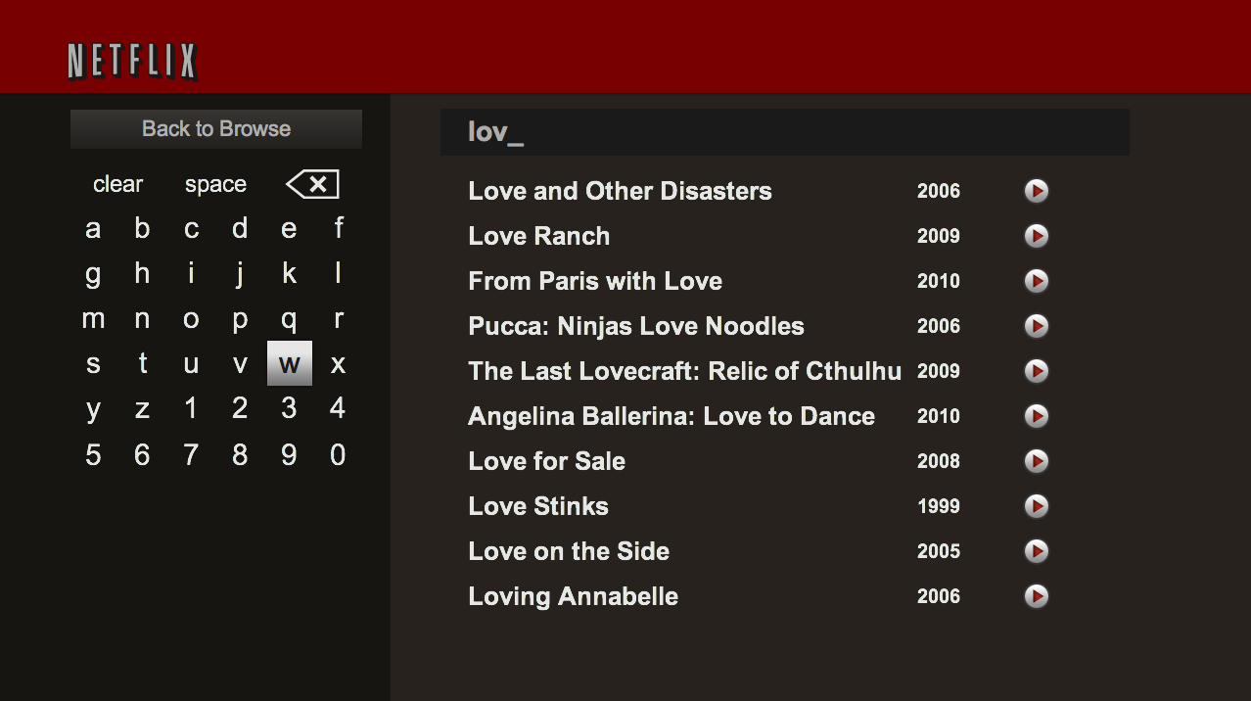
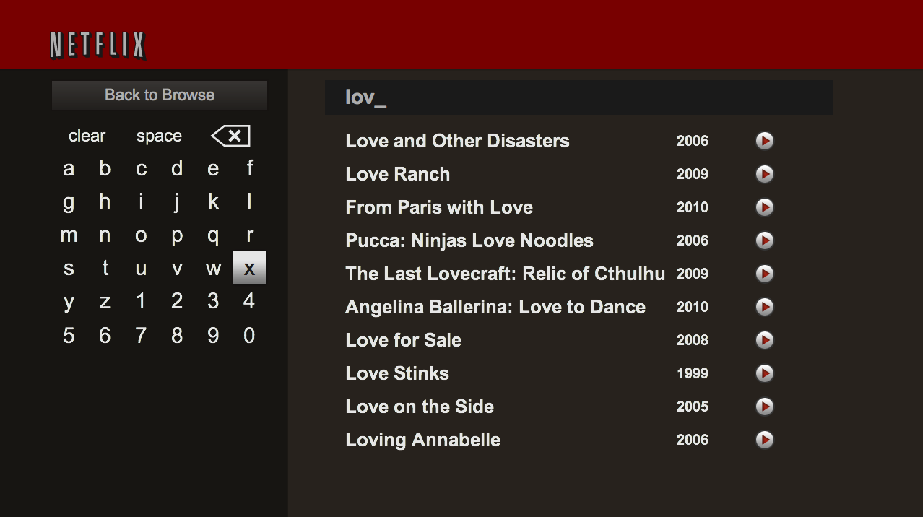
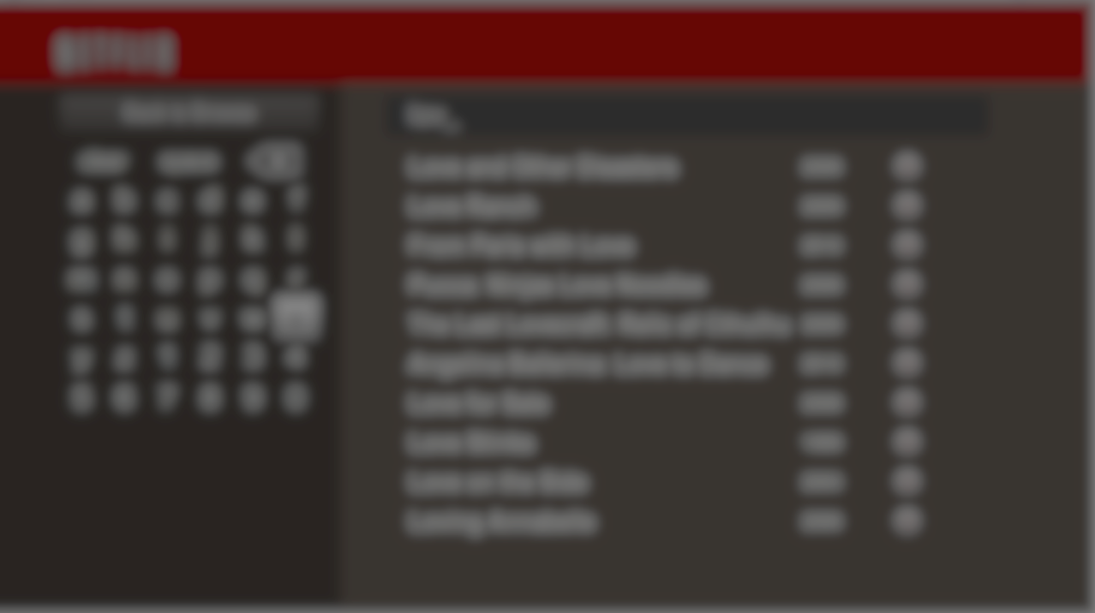
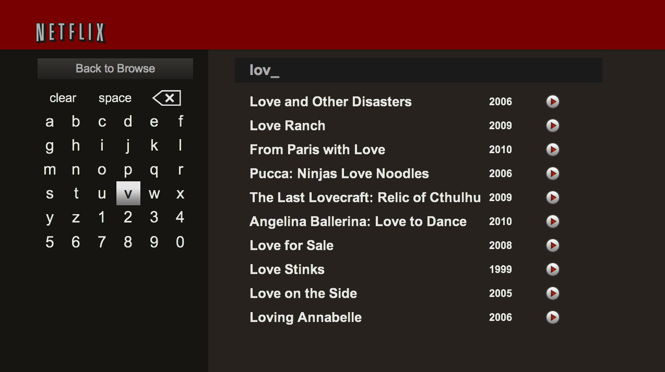
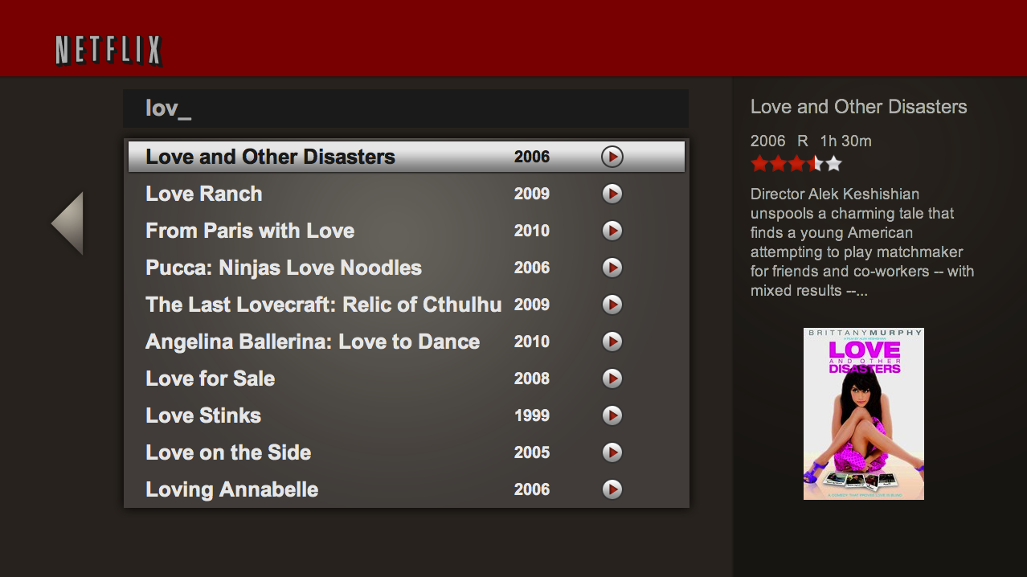
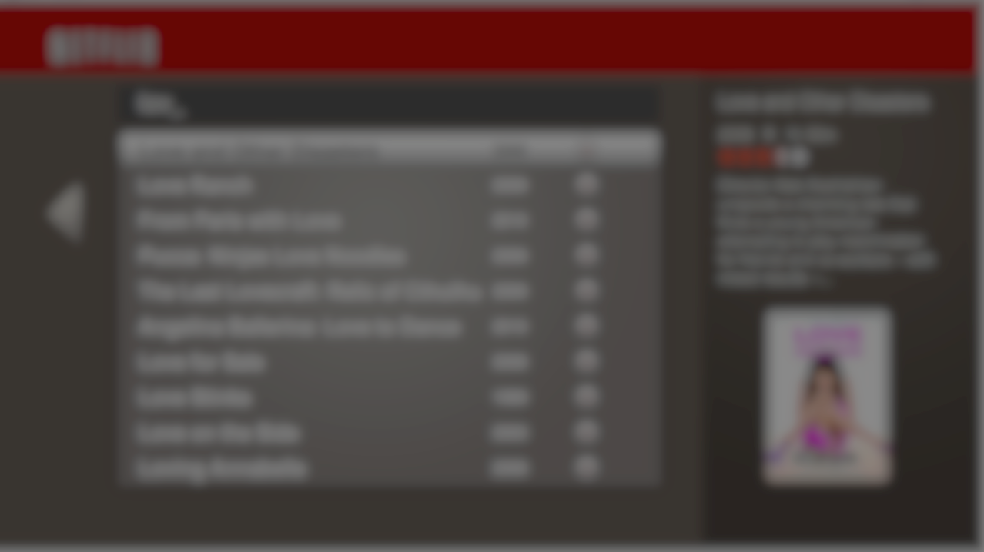
Search Input
State
Search Input
State
Search Input
State
Search Compound
State
Search Compound
State
Search Results
State
Search Results
State
Notes:
Supporting variation: State system example: Search
Search input <-> Search results
Compound state models the relationship between the two
- Owns transition criteria
- Causes transitions
Note that the results state still updates even when the input state is the active state.

Slide 29
PERFORMANCE AND MEMORY
building a lean, mean content browsing machine
Notes:
Why we worry about performance and memory
Strategies for improving performance and efficiently using memory

Slide 30

Why do we worry?
Single-page, long-lived application
High volume of data & images
Require high performance
Range of device capabilities
Notes:
Unbounded memory growth can occur, memory fragmentation
Impact performance: slowdown or cause crashes
App to feel snappy, smooth, consistent

Slide 31
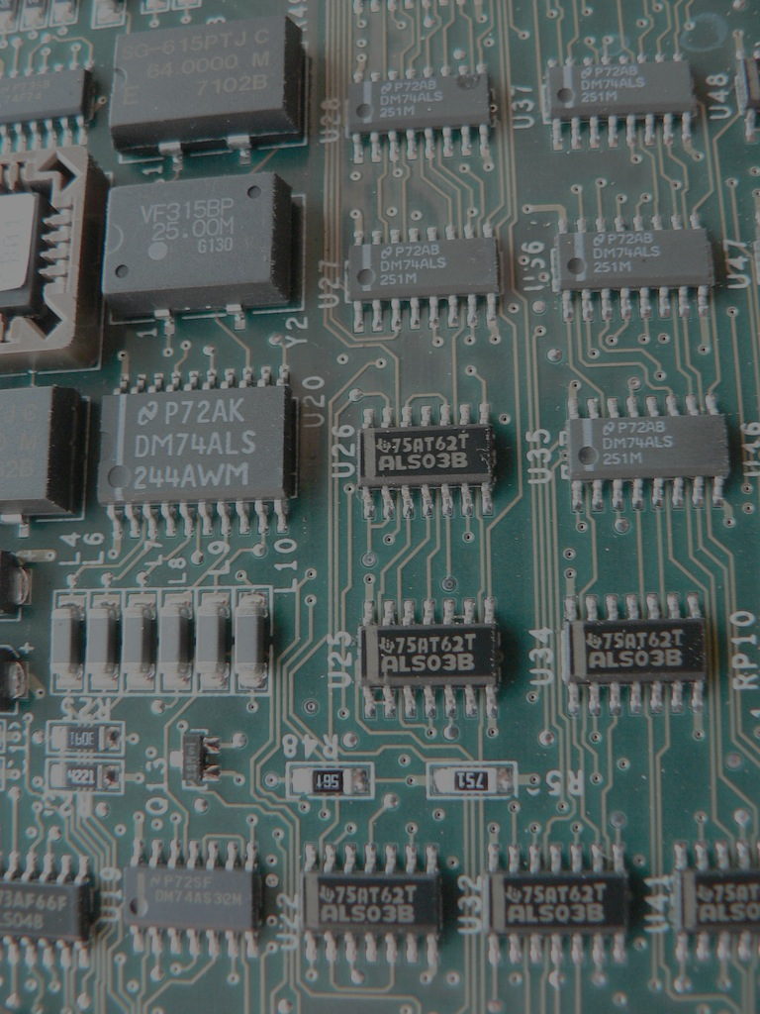
Device Ecosystem
Video Memory
CPU
GPU
Main Memory
CPU Architecture
Memory bus speed
Graphics driver
Network stack
Notes:
All of the things above can vary across devices and impact the performance and memory footprint
Credits:
Circuit Board by John Morris
http://www.flickr.com/photos/jm999uk/182396962/
Attribution-NonCommercial-ShareAlike 2.0 Generic (CC BY-NC-SA 2.0) http://creativecommons.org/licenses/by-nc-sa/2.0/
----- Meeting Notes (7/28/11 22:49) -----
Shorten talking points here

Slide 32



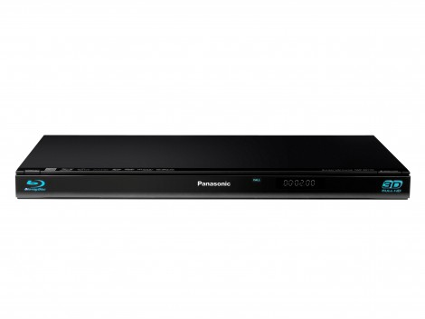
Device Ecosystem
CPU: 3.2 GHz
GPU: 550 MHz
Memory: 512 MB
CPU: 600 MHz → 3.2 GHz
Memory: 88 MB → 512 MB
Notes:
Just looking at CPU and memory alone, you can see that there's a wide range between the low and the high end
Graphics driver and GPU can really impact performance on these devices

Slide 33
Memory Budget
Total Memory
Operating System
Webkit
Netflix SDK
Network/Video Buffer
UI Budget
Notes:
Looks like we have a lot of memory available but we don’t get to use all of it
Lots of things competing for memory
Webkit is no small potato
Our port which uses Qt is ~20MB of code
Reduces the overall memory available to the UI
Others:
Background processes
Graphics subsystem

Slide 34
Progressive enhancement
Baseline
Enhanced
Animations
Request throttling
Cache sizes
Data pre-fetching
None enabled
5 concurrent
Small
Delayed,
Small batches
All enabled
20 concurrent
Large
Frequent,
Larger batches
Notes:
Group devices into classes and target configuration based on the device class: range of attributes
Currently, we have 3 tiers
Devices all start out in the middle tier and then based on performance are adjusted up or down

Slide 35
Perceived Performance
0.1 second: Feeling of instantaneous response
1.0 second: Keeps flow of thought seamless
10 seconds: Keeps the user’s attention
Nielsen 2010, 1993; Miller 1968; Card et al. 1991
Notes:
Optimize for perceived performance as opposed to quantitative: focus on improvements that reduce delays in responsiveness to user actions
Studies have proven this as well as our own qualitative research
0.1: Within 100 milliseconds provide feedback on user action. Longer and the perception of cause and effect is broken
1.0: Try to complete actions within a second. After 1 sec, provide feedback that the action is taking place: progress indicators
Up to 10 seconds: users start to lose attention, feel that the app is broken
A lot of what we deal with in perceived performance is within the sub 1 second range
References:
“Usability Engineering” by Jakob Nielsen
http://www.useit.com/alertbox/response-times.html
http://www.useit.com/papers/responsetime.html
“Designing with the Mind in Mind: Simple Guide to Understanding User Interface Design Rules” by Jeff Johnson
http://www.sapdesignguild.org/editions/highlight_articles_02/responsiveness.asp
http://www.sapdesignguild.org/editions/highlight_articles_02/perc_perf.asp
http://developer.gnome.org/hig-book/3.0/feedback-response-times.html.en

Slide 36
Ways to Improve Responsiveness
Provide immediate feedback on user input
Split up long running process
Mask and reduce perceived wait times
Background work and anticipate common requests
Notes:
Immediate feedback:
Don’t = key input ignored / failed. Repeat it. Result = navigate further then intended
Sacrifice immediate content updates in favor of immediate feedback
Split up processes:
Execution deferrer: do this when you have time. Examples: processing AJAX responses, events
Mask and reduce perceived wait times:
Spinner while we’re loading the movie metadata on our movie details page
During application start-up, we progress through text to give the user a sense that the application is proceeding
During playback startup, have a progress bar that progresses through metadata loading, license acquisition, buffering, etc.
Background work:
Pre-fetch metadata
Metadata = movie metadata and images (describe back a few slides)
Some applications or UIs might be able to take advantage of Web Workers
References:
“Usability Engineering” by Jakob Nielsen
http://www.useit.com/alertbox/response-times.html
http://www.useit.com/papers/responsetime.html
“Designing with the Mind in Mind: Simple Guide to Understanding User Interface Design Rules” by Jeff Johnson
http://www.sapdesignguild.org/editions/highlight_articles_02/responsiveness.asp
http://www.sapdesignguild.org/editions/highlight_articles_02/perc_perf.asp
http://developer.gnome.org/hig-book/3.0/feedback-response-times.html.en

Slide 37
Ways to Improve Responsiveness
Wait until the user settles for expensive operations or paints
Avoid DOM changes at the beginning of / during animations
Tune delays to find the sweet spot
Notes:
Settles:
User settles = stops navigating for long enough (200-300 ms) that we believe they intend to consume the content they’re focused on.
Opportunity for update content/metadata on the screen, prefetch metadata, perform delayed tasks
How: setTimeout that is cleared when another key input event occurs
Animations:
Wait until “webkitTransitionEnd” event, then slightly longer (timeout) to allow key input
Animations are timed based. Doing anything during eat up time having Webkit paint parts of screen, drop frames
Consistent and smooth has better perceived performance than inconsistent and jerky even if its faster.

Slide 38
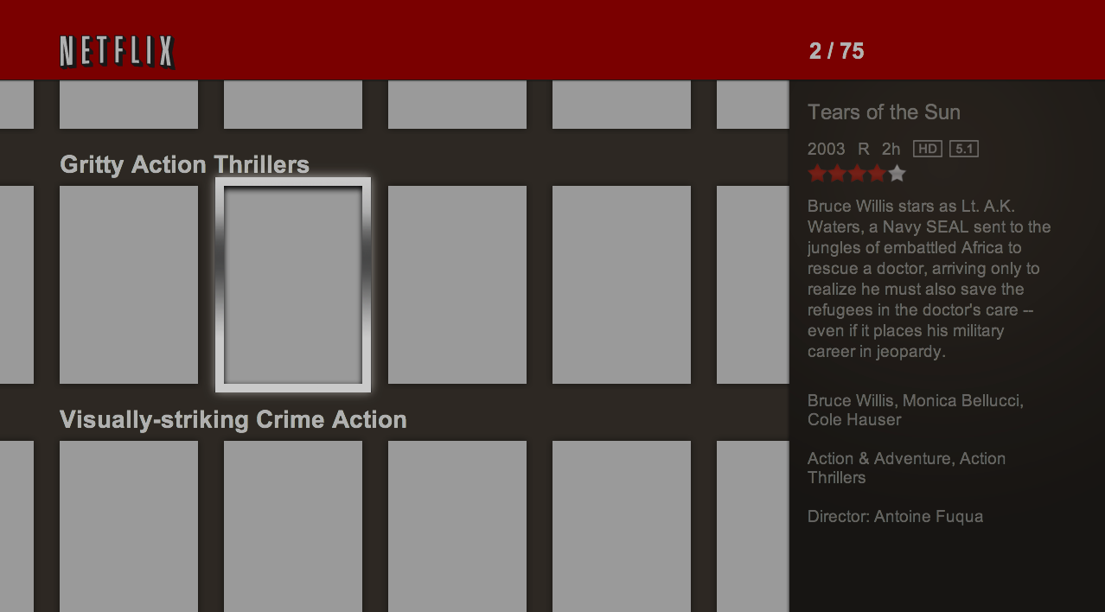

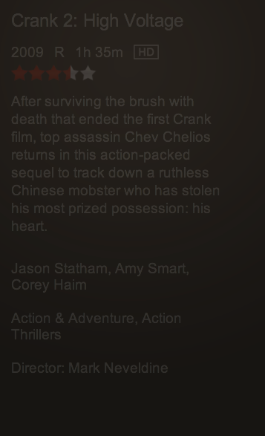
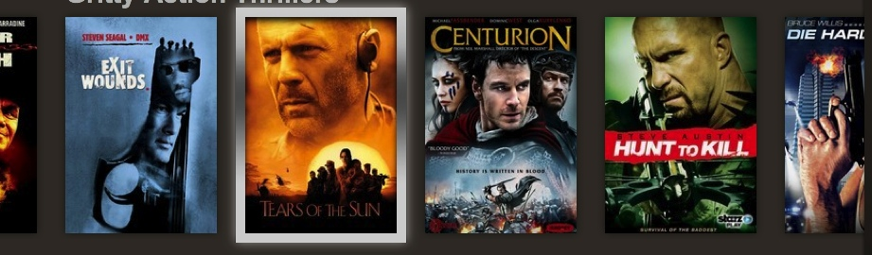
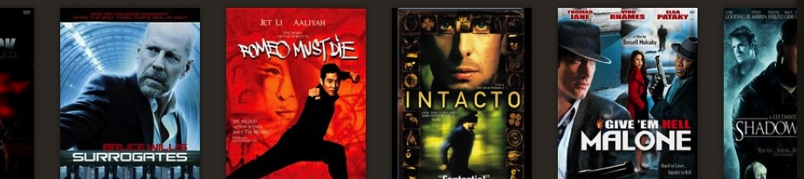
Provide Visual Cues
Notes:
Because memory constraints don’t prefetch and load all data (imagine endless rows vertically and horizontally)
Grey placeholders: user scrolled to area not loaded metadata or delaying updates in favor immediate feedback
Like during rapid scroll, don’t load movie boxart until user settles
Do update list titles to give context within the grid
Bob = back of DVD box: lower the opacity to show focus no longer matches
Save expensive paints since large portion of screen
Settle: update focused row and Bob first and stagger out rest of rows
Give time for key input in between. Avoid UI freezing up from large/expensive paints
Other visual cues:
Counter: provides context to where you are horizontally when the row of movies
Boots and caps (rows peeking through on the top and bottom) give user context that there is more to navigate to

Slide 39
Performance Evolution: Scrolling Rows
Naïve implementation
Progressively inserted new DOM nodes
Animated very large DOM parent
Height ever-growing of DOM parent
Bad: Performance degraded as you scrolled
1
2
3
4
5
6
7
Notes:
The blue boxes are rows of boxart and the dotted line is the viewport
Create and insert new DOM nodes into the parent node

Slide 40
Performance Evolution: Scrolling Rows
Optimized implementation
Recycle DOM nodes
Animate each row individually
Delaying modifying row until comes into viewport or the user settles
Good: Performance consistent regardless of location
1
2
3
4
2
1
5
Notes:
DOM recycling: reusing DOM nodes for other movie rows.
Don’t change their location in the DOM (don’t do any insertions)
Just change their visual position with -webkit-transform

Slide 41
Software (CPU) = slower
Hardware (GPU) = faster
Notes:
Take advantage of what the hardware is optimized for / good at
GPU designed for drawing and compositing operations that involve large numbers of pixels
Avoid computationally expense work in software

Slide 42
CSS = Software
Image = Hardware
Avoid CSS gradients, boxshot shadows
  Use images instead
Example: Full-screen CSS radial gradient
  Paints were 13 times faster without it
Notes:
Cool new CSS3 features can come at a cost on low-end devices
CSS can be very powerful but often you are doing work in software that can be pre-baked in images
Hardware can just paint images. CSS requires software to calculate, render and paint
Full-screen radial gradient was a background image and the UI was the foreground

Slide 43
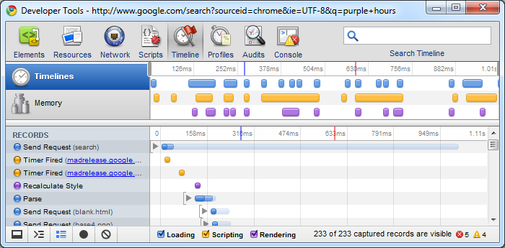
Eliminate paints
Notes:
Often can accidentally cause paints without realizing it
Rendering engine doesn’t optimize for no-ops, e.g. changing textContent to the same text
Minimize DOM manipulation
Localize changes: update attributes, e.g. img src, css, textContent
References:
http://code.google.com/chrome/devtools/docs/overview.html

Slide 44
Accelerated Compositing
Enables GPU acceleration of compositing parts of the page
Greatly benefits CSS animations
Notes:
Without accelerated compositing, animations would be slow
Every device we’ve seen has benefited from accelerated compositing, even high-end platforms like the PS3
Accelerated compositing trading memory for performance, but often devices have plenty of video memory

Slide 45
Accelerated Compositing
DOM Tree -> Render Tree -> RenderLayer Tree
Software path
Changes to a render layer require repainting all overlapping layers
Hardware path
Some render layers paint to their own backing surface (compositing layer)
Changes to a layer only repaint the contents of that layer
Notes:
Render Tree: Each node in the DOM tree that produces visual output has a corresponding RenderObject
RenderLayer Tree:
Each RenderObject directly or indirectly has a RenderLayer
RenderLayers exist so that the elements of the page are composited in the correct order to properly display overlapping content, semi-transparent elements, etc.
Hardware path:
Compositing layer = bitmap in video memory (unless it’s a container)
References:
http://www.chromium.org/developers/design-documents/gpu-accelerated-compositing-in-chrome

Slide 46
Several ways to create layers
3D transforms
Opacity changes
Accidental
  Overlapping a layer
  Render engine
Notes:
Easy to accidentally create them
Overlapping an element on top of a layer will create an implicit layer of that element
Render engine may choose to render an element as a layer

Slide 47
Leveraging layers
Safe CSS properties
  Transforms
  Opacity
Un-safe
  Any other CSS properties
  DOM manipulation
Notes:
Safe CSS properties to change on a layer that will not cause it to re-render the layer
Unsafe
Any other properties are not safe to modify
DOM insertions, manipulation (attributes, textContent)

Slide 48
Tips
Keep layers small
  Don’t inadvertently create gigantic layers
  Memory consumption = width x height x 4 (bit depth)
Animate smaller areas rather than large parts of the screen
Trial and error, testing important
Notes:
Gigantic layers: text-indent -8000px
Some devices paint larger areas slower
You could actually make it slower if you just turned everything into a layer
Not always intuitive what improves the performance: trial and error is important
Use the tools to verify the performance on actual devices

Slide 49
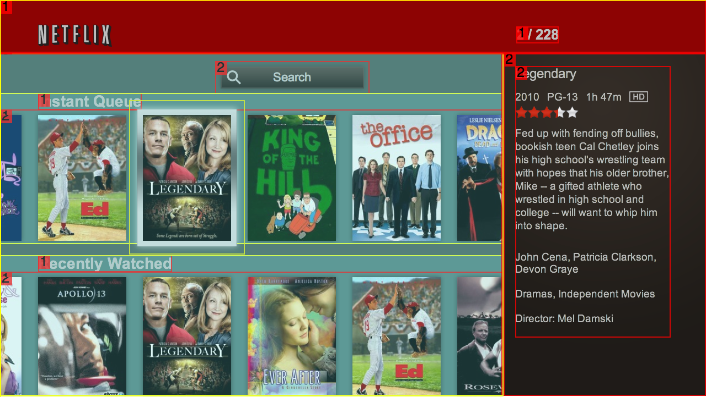
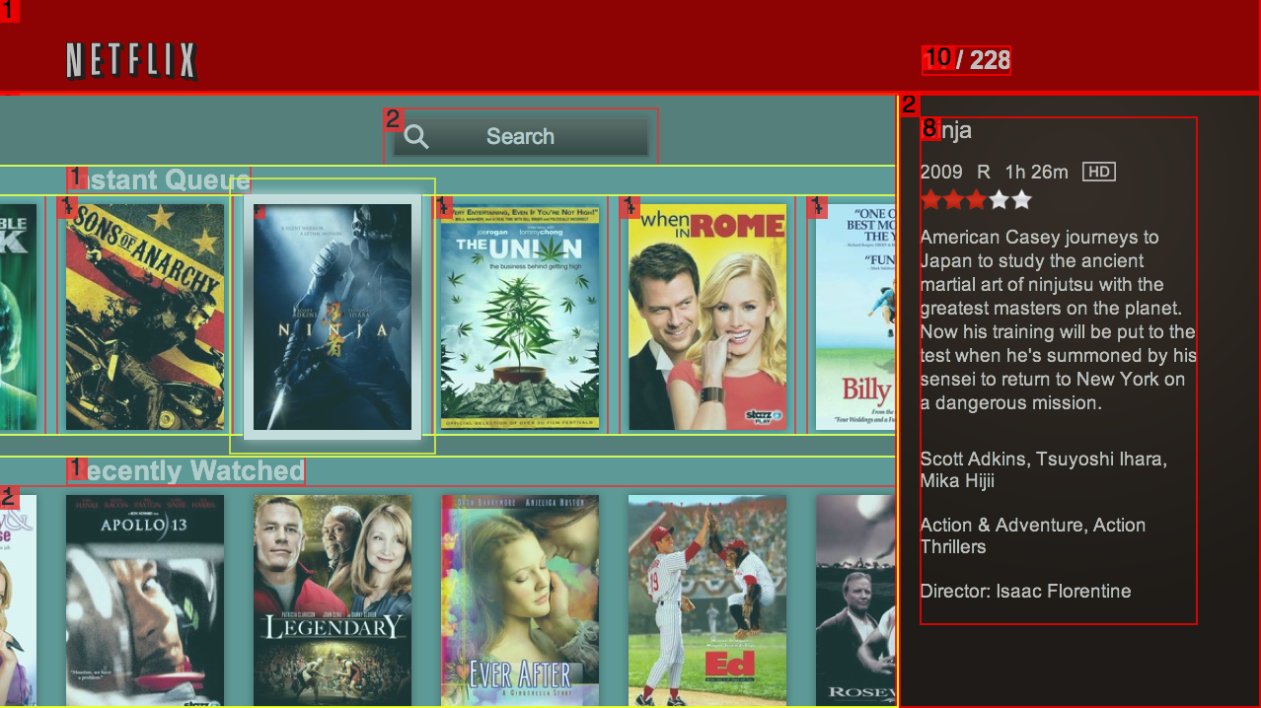
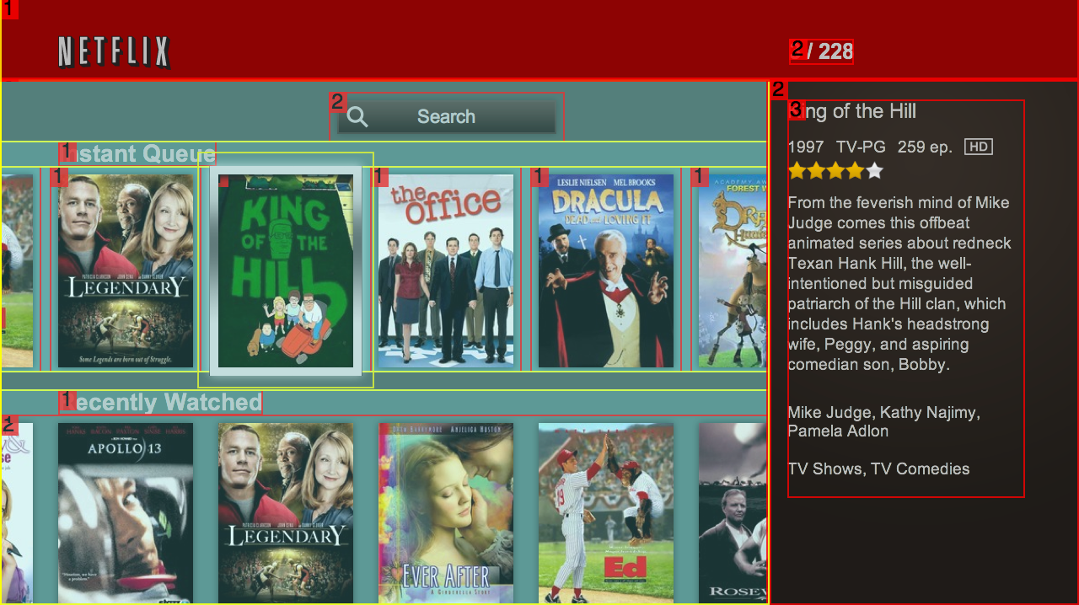
Show Compositing Borders
Notes:
Mention available in Safari and Chrome
Describe visual hints
Discuss optimizations: vertical up/down and horizontal left/right navigation
Visual hints:
Red – a layer
Yellow – container
Number in the top left corner of the layer indicates how many times it has been repainted.
Cyan – Helps with debugging “overflow”. Not expensive for memory
Green – Tiled layer. Created when the layer width/height is > 1024
Optimizations:
Each row has 2 layers: one for the title, one for the boxart
Allows fast updates to the title during rapid scrolling as it’s a smaller area to repaint then 1 big layer for the row
For each row animating 2 layers
Left to right, breakdown the boxart layer into individual layers for each boxart
Optimizes for left/right animation and recycling the boxart nodes
Counter updates for each key input but didn’t for the movie details layer since only does when user settles
Enabling in Browsers:
Safari
On terminal run following command:
defaults write com.apple.Safari IncludeInternalDebugMenu 1
Go to "Debug" Menu and select "show compositing borders”
Chrome
about:flags
Enable “Composited render layer borders”

Slide 50
Memory
Avoid unbounded growth
Minimize the number of throwaway objects
Use closures sparingly & only where necessary
Dynamically load and unload code
Notes:
Unbounded:
Eliminate references to free up for garbage collection
Use pools to fix sizes and re-use objects, e.g. DOM elements
Objects:
Lots of objects will cause more frequent and slower garbage collections
Unpack options object
Memory fragmentation
Video buffer needs a large contiguous block of free space. Too man small blocks = can’t allocate large
Closures
Avoid persistent closures that increase the scope chain and memory footprint
Loading:
Infrequently visited areas of the app

Slide 51
What’s Next?
i was led to believe there would be flying cars
Notes:
What’s next
Devices
- New game consoles with novel capabilities
More UI and feature testing
Input types
- Pointer: We’ve already developed some UIs for TV devices with pointer input.
- Touch
- Motion/gesture
- Voice
Performance tuning
- Greater capabilities on inexpensive devices
- Greater capabilities on high-end devices

Slide 52
Questions?
Matt McCarthy – mmccarthy@netflix.com – @dnl2ba
Kim Trott – ktrott@netflix.com – @ktrott00

